Slide 1
Working Title: Cyber Aztecs
Made by
Emilia Nilges
Niklas Weber
Daniel Bosselmann
Niklas Burrichter

Slide 2
Game concept
Genre: 2 Player Jump´n´Run
Core Gameplay:
Running
Jumping
Building Platforms
Key Features
Building Platforms
Platform: PC
Target Audience: Every age and skill level

Slide 3
Backstory & Setting
In a dystopian alternate future of Aztec mythology created by the Cyber Gods, the civilizations live dominated under a dome. But a mysterious Robot and a drone break through the outer shell of the dome and bring danger to this society. Their destination: To take down the last of the Cyber Gods.

Slide 4
Project vision
Cooperative gameplay
Solving problems together
Creating unique game world
Mixing Sci – Fi and Aztecs elements

Slide 5


4 – 2 – 1
4 Walls: City under Dome
2 Players: Robot & Disc
1 Problem: To free mankind

Slide 6
Gameplay loop & Video
Presentation of the core game loop, ideally as prototype.

Slide 7
Team Roles & Responsibilities

Slide 8
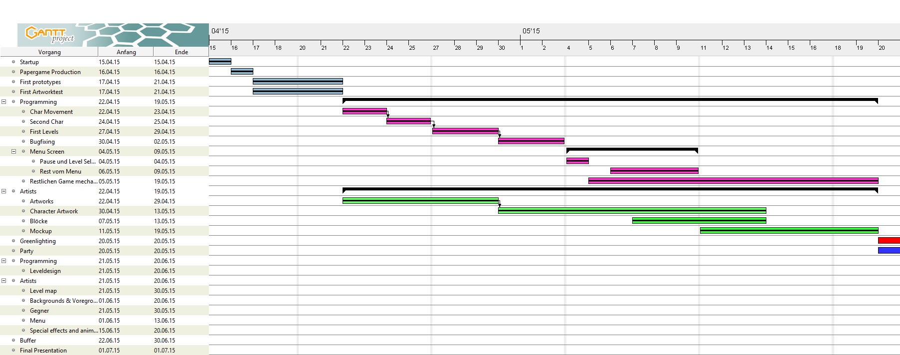
Production Schedule before Greenlight

Slide 9
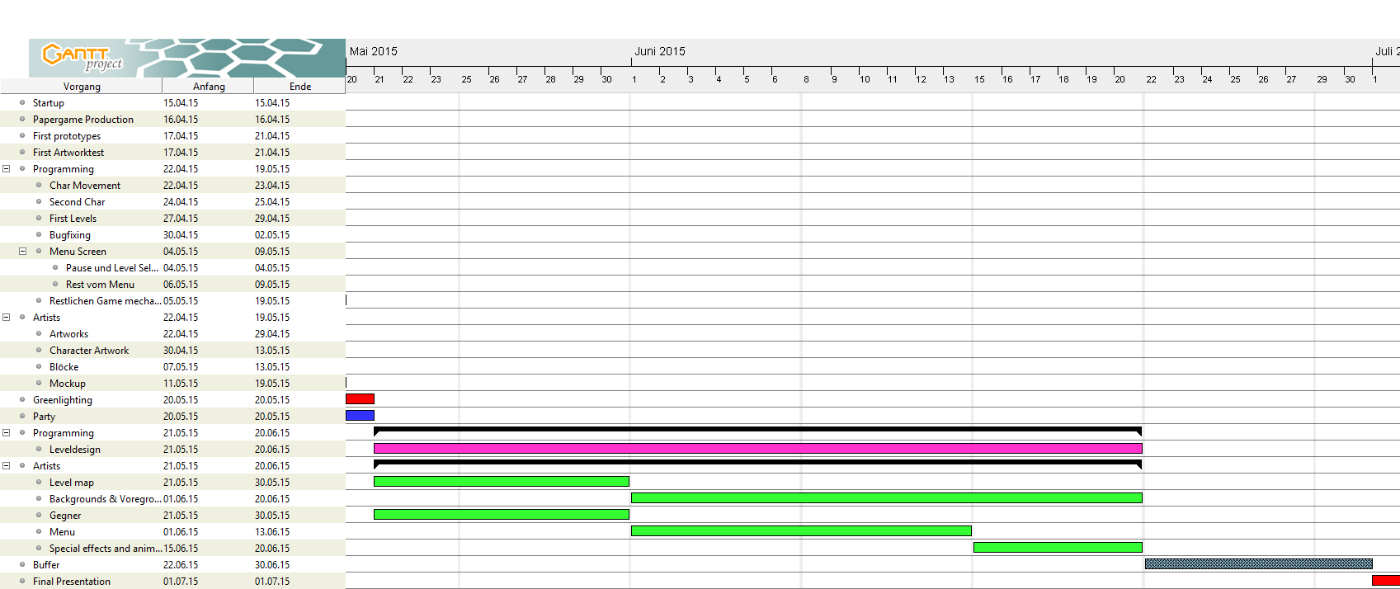
After Greenlight

Slide 10
Mockup representing the targeted visual quality including character design, environment concept, mood and style sheet, animation tests.

Slide 11
Mockup

Slide 12
Character design

Slide 13
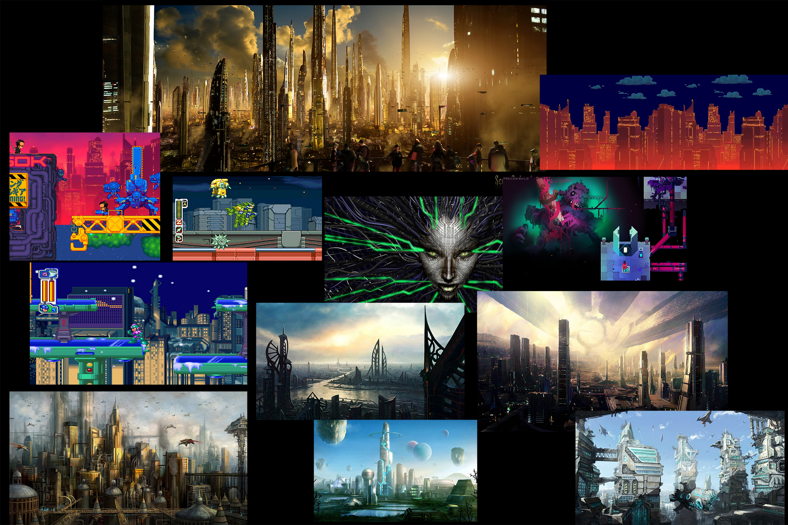

Slide 14
Sound concept including examples.

Slide 15




Technical game document

